Slide 1
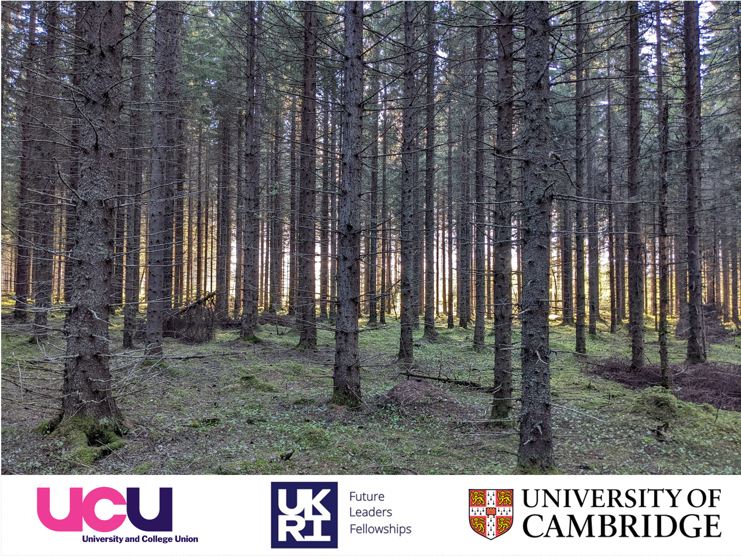


Terrestrial Laser Scanning
for forest geomorphology
Stuart Grieve, Harry Owen, Paloma Ruiz-Benito & Emily Lines

